Slide 1

Artificial Intelligent Responder
Major Project Presentation
-the future tutor of your child
Project Supervisor :
Prof. Vaneet Singh Mr. Parveen
Student Name :
Gaganpreet Singh
Notes:
This presentation demonstrates the new capabilities of PowerPoint and it is best viewed in Slide Show. These slides are designed to give you great ideas for the presentations you’ll create in PowerPoint 2010!
For more sample templates, click the File tab, and then on the New tab, click Sample Templates.

Slide 2
The Project
A
I
R
Artificial
Intelligent
Responder
-the future tutor of your child

Slide 3
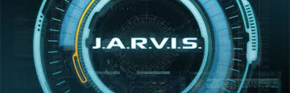
Introduction
The Idea for this project came from the movie “IRON MAN”.
In the 'Iron Man' films, J.A.R.V.I.S. (short for Just A Rather Very Intelligent System) is the name of Stark's AI system that assists him in superhero-ing.
We were interested to create something of that sort which helps people to get the relevant answer of their query within a few seconds without wasting too much time on the Internet.
The aim is to develop a Virtual Tutor, where we can strive towards providing high quality education to children.

Slide 4
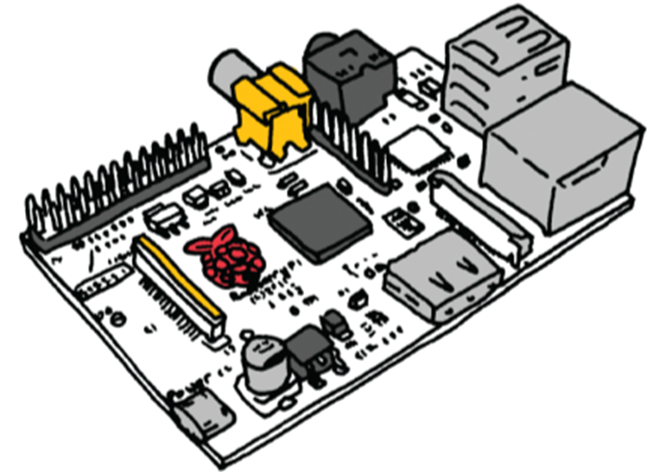
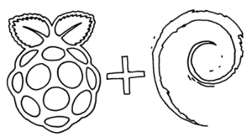
A.I.R. is powered by ARM based Raspberry Pi MCU (Model B).
The Rpi is connected to a 3.5” touch LCD via GPIO pins of the pi; interfacing of this LCD posed problems as there is no official support for its interfacing.
To make A.I.R. portable we have connected a 10,000mAh power bank to the Rpi which can run it for over 8 hours.
4. Wi-Fi adaptor has also been integrated in Pi to provide wireless Internet access.

Slide 5
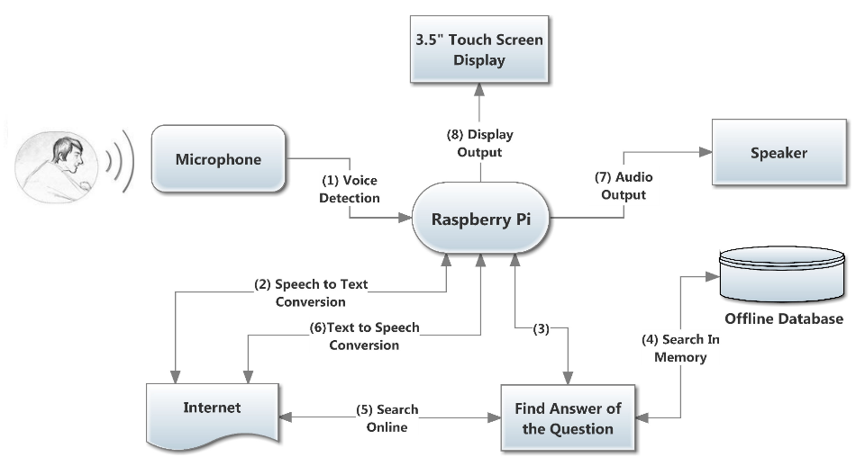
Block Diagram
Introduction

Slide 6
The 4 DB’s …….
The working of Artificial intelligent Responder is based on 4 types of Database described below:
Pre-Built Database
Contains answers to all the questions related to AIR and its owner.
Internet Database
Answers that are fetched from the internet are stored in this database, so that whenever the same question is asked again the answer could be easily retrieved from the Database without accessing Internet.
Command Database
There are certain commands that help user to see the last question and its corresponding answer . Moreover, user can update the internet database using the update command in order to get up-to-date result.
Session(LOG) Database
The moment AIR is powered up, a new database is created which contains all questions asked by the user regardless of whether the answers were provided or not.

Slide 7


Flow Chart
START
Voice Input by user
Speech to text using HMM
Save into session database
Text Splitter
Match Split Text in Command Database
Execute the command
Find the correspond Command
Yes
No
Match Split Text in pre-built Database
Convert Into Voice
Modify Answer for display
Save into Session database
Find the correspond Answer
Yes
No
Match Text in Internet Database
Yes
No
Submit the Query to wolframalpha
STOP
Negative Answer
Smartly save question and answer into internet database
Yes
Answer Found
No

Slide 8

How is A.I.R different from GOOGLE NOW & SIRI ?
A.I.R. tries to provide exact results rather than providing list of relevant webpages; hence saving a lot of time.
It can solve Complex queries like polynomial, algebraic and astronomic calculation easily.
Queries that we have tested successfully with AIR include:
Mathematics
Units and measurement
Dates and times
People and history
Physics
Weather
Astronomy
Properties of Materials
Nutrition
English Synonyms and Antonyms

Slide 9
Features
Instant Answer
Portable
Time Constraint is always a crucial factor for determining the performance of various system, i.e. the reason why we used Multiprocessing in A.I.R so that it gives the answer within 6-8 sec.
Portability gives LIFE to the device!
With a 10,000mAh power bank AIR can run up to 8 hours.
AIR can be used anywhere without worrying about the power supplies.

Slide 10
Features
Eidetic Memory
Bandwidth Optimization
AIR allows user to see the last question that he asked and the response that A.I.R. provided for that question
AIR works smartly and saves all the previously asked questions into an Offline database, so that whenever the same question is asked again the answer could be easily retrieved from the Database, hence saving the bandwidth and time.

Slide 11
Features
Intelligent Mechanism
Intelligent Voice cut-off
Not every answer coming from the internet is saved into the offline database!
There might be some questions that are time sensitive, so these are not saved and every time such questions are asked , the query is submitted to Internet.
When the user has finished speaking to A.I.R. , the cut-off mechanism identifies it and automatically stops recording. It then converts the voice into text and submits the query on Internet

Slide 12

The Future Plan: Language tutor
Apart from answering questions, we have also integrated Language Translation in A.I.R. using which one can easily convert an expression from one language to another!
The language translation feature can help you to learn new Languages.

Slide 13
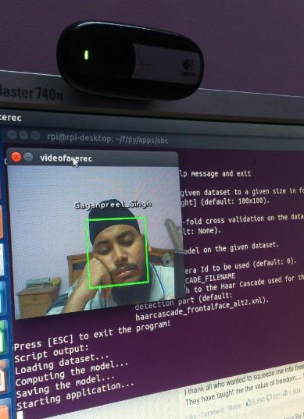
The Future Plan: Face Recognition
In the future, we plan to connect a Logitech camera with AIR
This will make it more interactive so that it could recognize the people that it is dealing with.
AIR might also greet people with there names.
In cases where it is not able to answer a question it might ask the person to teach him that he does not know !

Slide 14
Work in Progress !
Glimpse of Face detection module

Slide 15
Industrial & Home Automation
Home Automation
Simple tasks like opening garage door, detecting gas leakage or monitoring other household chores can be easily accomplished using AIR
Industry Oriented
The machines in Industries can be easily operated using AIR.
All one has to do is connect control pins of the machines to the Rpi GPIO and AIR will provide real time monitoring of the devices connected to it.

Slide 16
Conclusion
The aim of the project is to develop a Virtual Tutor, where we can strive towards providing high quality education to children.
We made this system as simple as possible so that a newbie can easily learn how to operate AIR without much hassle.
AIR can be designed with a low cost hardware so that it can fit in everyone's pocket.
Air can be made more compact if implemented using SMD (Surface Mount Device) technology.
“ We hope that our efforts will take the learning experience one step forward! “

Slide 17


Thank You

